Slide 1
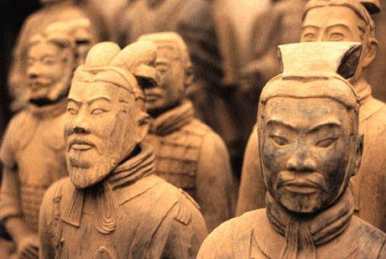
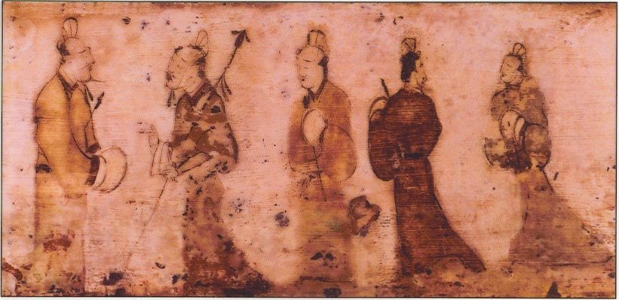
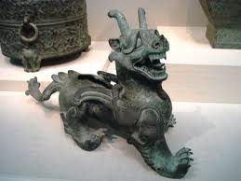
The Unification of China:
The Qin and The Han

Slide 2
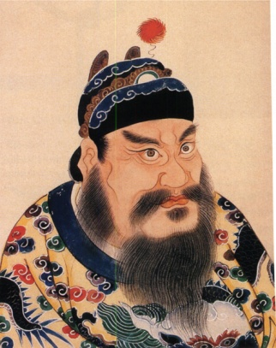
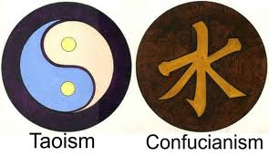
China: Qin and Han
As Rome rose, China recovering from Warring States Period (end of Zhou)
Three belief systems emerge in response to how to solve China’s problems
Legalism – humans naturally evil and will only obey through force
Daoism – avoid useless struggles and follow the Dao, the path. Turn to nature; focus on acceptance and individual retreat from society.
Confucianism – emphasize importance of hierarchical, harmonious relationships for an orderly society. Family is the foundation that serves as a model.
If you were the Qin emperor, which philosophy would you choose to apply to your rule?

Slide 3
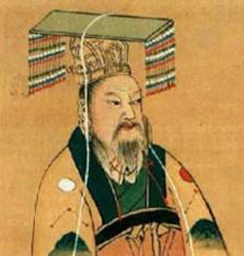
China: The Qin Dynasty- before control
Qin leaders responded enthusiastically to Legalism
Used strict rule to dominate neighbors in western China
Iron weapons helped army defeat other states until it controlled China
King declared himself “First Emperor” or Shi Huangdi (ruled 221 – 210 BCE)
Dynasty didn’t last long but is significant in regard to the development of the Chinese state

Slide 4
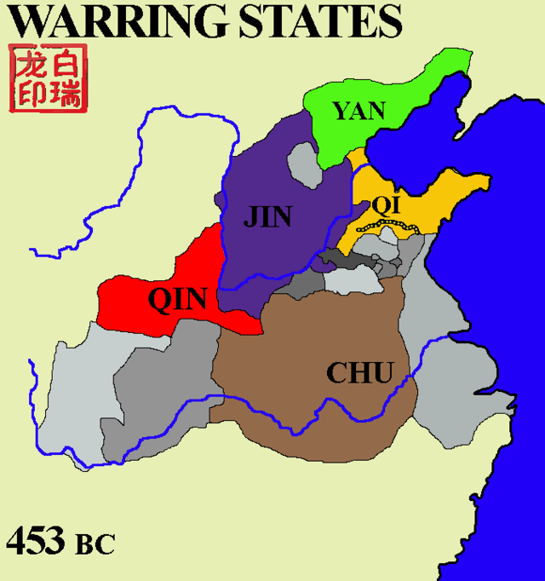
Notes:
7 states in China during the Warring States period fighting the Zhou for control.

Slide 5
Origins and Rise to Power
During Warring States Period:
Zhou allied themselves with the (western) Qin to defeat the nomads attacking from the north.
Zhou gave Qin lots of land (fiefdom- feudal system) in return
Over 8 centuries → force to be reckoned with!
Big boss: 21 yr old Qin Huang
Family drama
Ruler during “Unification Wars”. (moving map)
Won due to:
Size – army of 600,000 (compared to Rome, sacked Carthage with 6,000 v. Greek armies of 40,000).
Crossbow – bronze triggers=rapid fire; 3 sided arrowheads; used 10 centuries before Europeans; 3 line shooting formations.
Swords- longer than most (close to 8ft); chrome (not patented until 1950’s).
Notes:
Family Drama: he discovered there was a plot against his life – between his mother and her lover, Lao Ai and the Prime Minister Lu Bu Wei. So, he had his mom banished and her lover, Lu Bu Wei, committed suicide. Huang also had his step brothers killed. So, he became very untrusting and never took a wife.

Slide 6
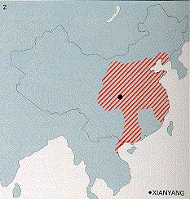
Qin Dynasty

Slide 7
3. The Qin Dynasty in China (221-209 B.C.)
Unlike the Zhou, the Qin Dynasty was extremely short… lasting little more than a decade
Connected fortified walls (Great Wall?)
Did any of the walls built actually prevent invasions?
Qin Shi Huang di first emperor
Notes:
Great Wall of the Qin, not the real Great Wall of today- that’s the Ming.

Slide 8
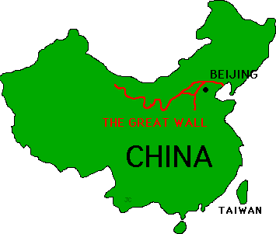

Slide 9
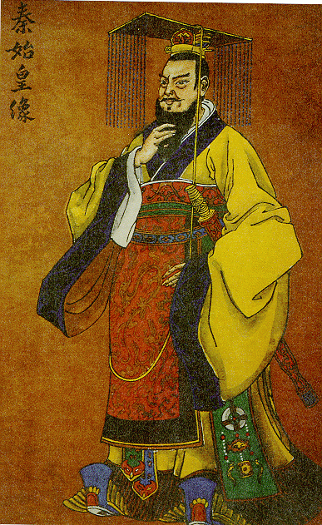
Qin Dynasty (221-202 BCE)
Qin Shi (Xi) Huang di challenged the Zhou (lost mandate of heaven); won & began the Qin Dynasty &became the 1st “emperor”(greater than king)
After years of chaos during the “Warring States Period”, Qin Shi (Xi) Huang di used abusive political style to maintain order (executed opponents, book
burnings)

Slide 10
Ruling China: The Qin Dynasty
“Consolidate and Centralize”
Shi (Xi) Huang di
Centralized bureaucracy
ordered 120,000 families to abandon homelands to live in capital with him.
36 districts
Old fortresses destroyed
Used legalist doctrine to strip power from nobles
Will of the ruler over all!!!
Rewards and punishments
What type of political system does that translate to?
Divided China into administrative provinces with administrators he controlled
Built roads to facilitate communications and move armies
First fortifications of the Great Wall
Tomb of the terra cotta soldiers
Sentenced Confucians who complained to death
Burned the books of philosophy, ethics, history and literature
Patriarchal
Harsh but strengthened China
Standardized laws, and currencies
Standardized writing: Mandated that the Shang script be used – common script for communication
Peasant revolts after his death paved the way for the Han Dynasty
Notes:
Legalism = Totalitarian political system (subordinate individual for the needs of the state).

Slide 11
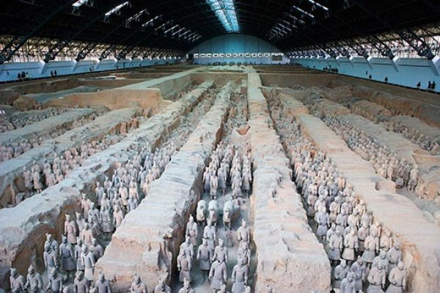
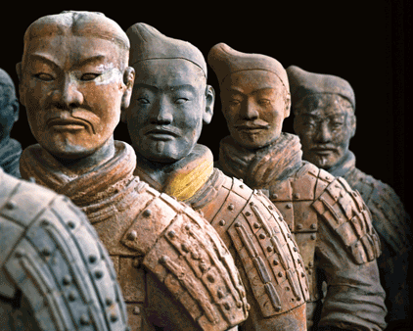

Slide 12
Qin Dynasty
On map, identify & label the following:
Outline Qin Dynasty
Draw Great Wall
Symbolize 3 important cultural achievements of Qin Dynasty

Slide 13
Get It Together!!!!!!
SPICE up the Han Dynasty!!!!!!!

Slide 14
SPICE IT UP!
Social:
Patriarchal
Women subordinate
Everyone subordinate to Emperor
Political:
Totalitarian (subordinate individual for needs of the state)
Standardized laws
Powerful army
Iron weapons
Interactions with Humans and Environments:
-metallurgy
Executions
Built roads and canals that connected people/ cultural diffusion and better able to move armies quicker through empire.
Culture:
anti- Communist thought and thinkers
Legalism
Anti-history books
Standardized writing & currency (weights and measures)
Economics:
- Strong ag.

Slide 15
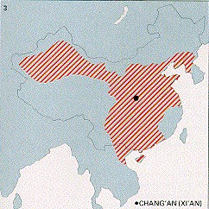
Han Dynasty

Slide 16
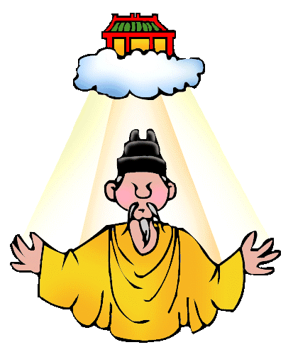
Han Dynasty (202 BCE-220 CE) China: the Han Dynasty Political Development
Liu Bang brought China quickly under control to end peasant revolts against the Qin.
Strong ruler who chose able bureaucrats
Han organized and controlled through nonhereditary bureaucracy (similar to Rome)
Family hierarchy the basis for government structure (owe obedience to the emperor)
Mandate of Heaven – “Son of Heaven”
Legalist AND Confucian values

Slide 17
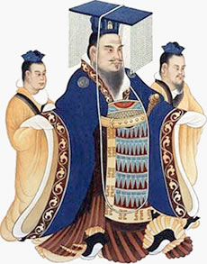
China: the Han Dynasty Political Development
Han Wu di
Warrior Emperor
Powerful ruler
Nobles had to divide land between sons to break up large estates (checked the lords power)
Centralized power in government
Han rulers expanded the frontiers and increased trade (increased contact with other peoples)
Confucian Civil Service Exam: exams for his bureaucrats
Nomadic people to the north a threat; easily get around the early fortifications of the Great Wall
Wu di’s forces defeated the nomads and annexed their land
Parts of Korea and SE Asia came under Han control

Slide 18
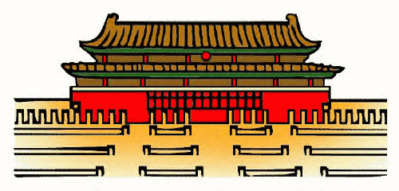
China: Economic Developments and Social Distinctions
Thriving urban empire – 30% of people in towns and cities
Forbidden City
Administrative buildings and houses of aristocrats and scholar gentry surround
Canals built/road systems expanded for trade
Allowed Buddhism to spread
Silk most important export

Slide 19
China: Economic Developments and Social Distinctions
Merchants looked down upon
Shi – scholar bureaucrats or mandarins had higher status under Han than Qin
Han rulers promoted Confucianism
Through what?
MARKER EVENT: University for scholars, examination system to identify the best candidates for jobs (only men)
Based on knowledge of Confucian texts
In theory, open to everyone
In reality, only the sons of the wealthy had time to study and prepare
Positions mostly to scholar gentry and aristocrats
Hereditary from father to son
Notes:
Civil service exam

Slide 20
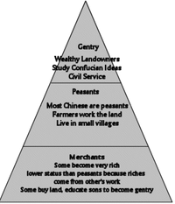
China: Social Distinctions
Three main social classes:
Scholar Gentry
Linked to the shi. Status based on large estates and govt positions. Homes in city and countryside; wealth passed down through family.
Ordinary, but free, citizens
Peasants; some had significant amount of land. Most lived well but others forced to work for landlords. All required to spend certain number of days each year on public works; could be forced to join army.
The underclass
Includes many peoples; non-Han Chinese, bandits, beggars, vagabonds.
Less slavery than in Rome

Slide 21
The Han Dynasty (Silk Road)- 4,000miles

Slide 22
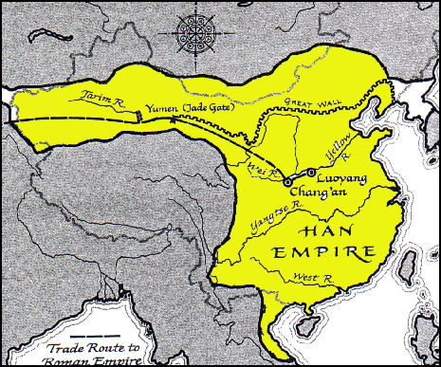
China: Decline of the Han
Lasted for 400 years; in decline the last 200 years
Nomadic invasions – Xiongnu
Mobility & weapons
Trade to meet needs through peaceful trade, but that didn’t work for long and they fought and took what they needed/wanted.
Han tried to keep them happy by arranging marriages between them and paying them tribute…
Issues defending long borders
Land distribution problems
Local nobles gaining power
Official corruption and inefficiency in government
Peasant uprisings
Han suffered the ill effects of the dynastic cycle and a period of chaos ensued after the fall for 135 years.

Slide 23
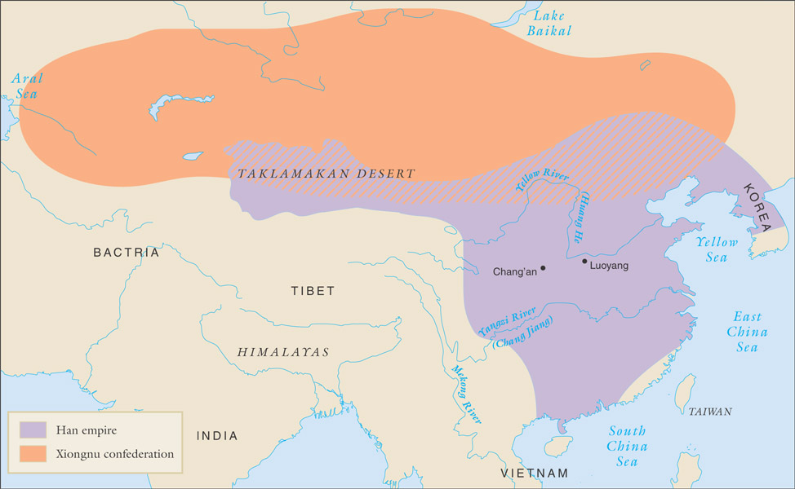
Legacy of Han Wu di
Confucian educational system
Expansion

Slide 24
Comparison: Rome and Han
Huge empires with long borders to defend
Walls
Chain of forts and garrisons
Time, effort, and money spent to defend borders from nomadic attacks (both failed)
Economies based on agriculture
Grew into wealthy urban-based societies
Land ownership issues between peasants and aristocrats
Peasants rebelled when reduced to tenant farmer status
Spread out from homogeneous core to encompass diverse peoples
Created cultural unity among conquered people
Delegated ruling authority to local officials
Competent bureaucracy allowed the empires to thrive for years

Slide 25
Han Dynasty
On map of Han Dynasty, identify & label the following:
Outline Han Dynasty
Draw Silk Road
Symbolize 3 important cultural achievements of Han Dynasty

Slide 26
Get It Together!!!!!!
SPICE up the Han Dynasty!!!!!!!

Slide 27
SPICE IT UP!
Social:
-3 main social groups:
Land-owning aristocracy
Laborers
“mean people” (lacking skills)
**(Merchants & money-making was not seen as important, even though they made A LOT!)
-Men superior to women because only men could carry out gov’t or religious duties.
What does this say about the priorities of Chinese society as opposed to Egyptian society?
Political:
Legalism AND Confucianism
Civil Service Exam
Interactions with Humans and Environments
-Sponsored public works: irrigation, canal, and road systems
-Chinese influence spread into Northern Korea, Northern Vietnam, and Central Asia
Culture:
-kept up currency system established by Qin
-Decorative arts – bronze and ceramic figures, bowls, vases, jade and ivory carvings, woven silk screens
-Calligraphy
-Historical record keeping important
-Mathematics, geography, and astronomy valued
-Acupuncture
Economics:
-expansion of trade
-agricultural based – regulated ag by storing grain and rice in good times to control price increases
-Brush pen and paper facilitated work
-Water mills for agriculture
-Rudders and compasses for ships
-New mining techniques for iron and copper
Notes:
Egyptian society: Women rulers; not seen in other river valley civilizations

